Slide 1

Adacanced Electromagnetic
School of engineering
September 13, 2024
1

Slide 2
Problem 1

Slide 3
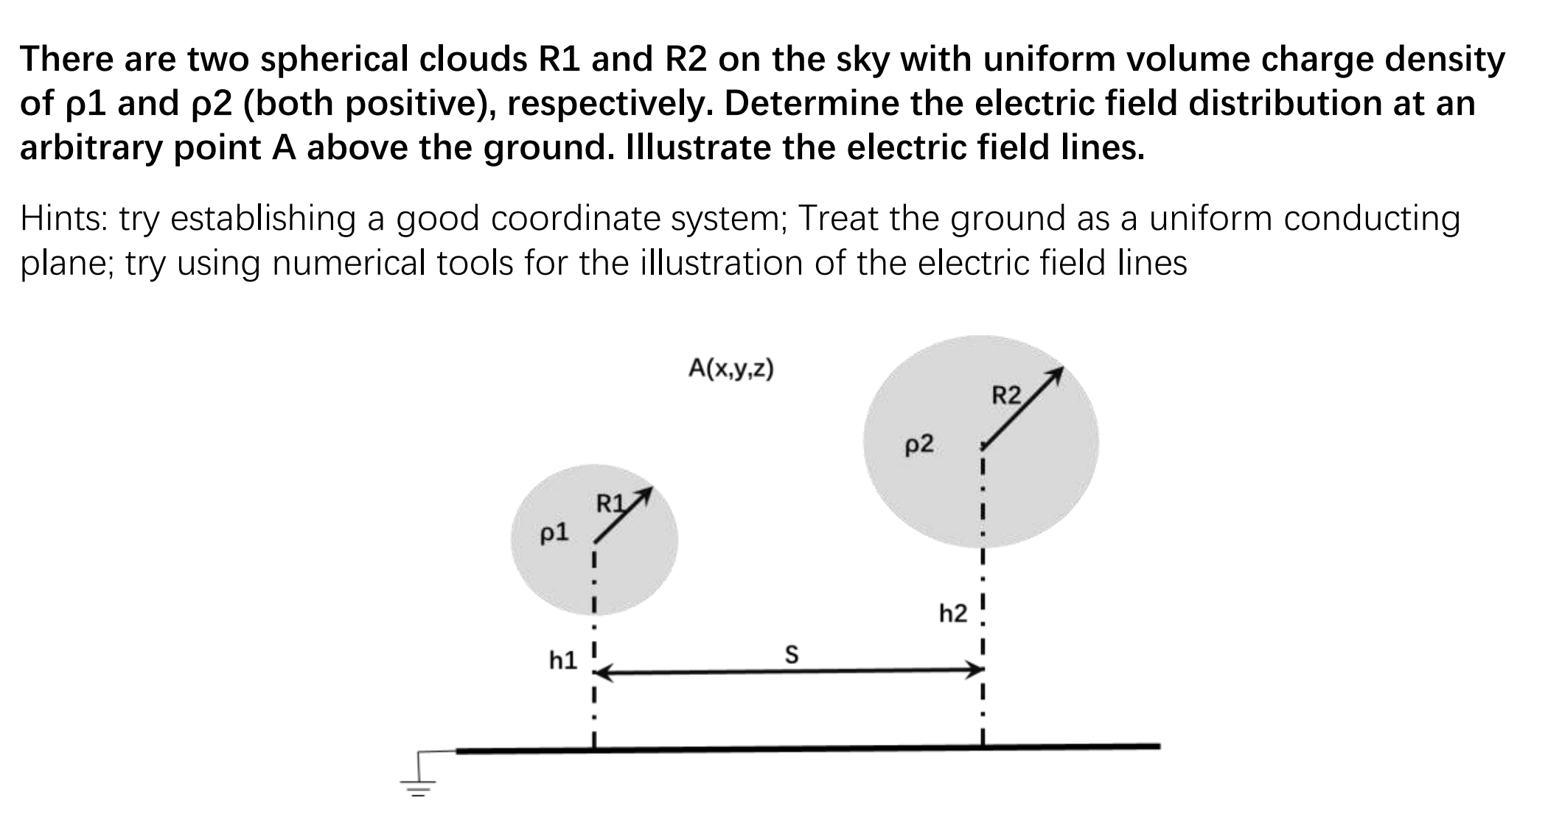
Problem 1

Slide 4
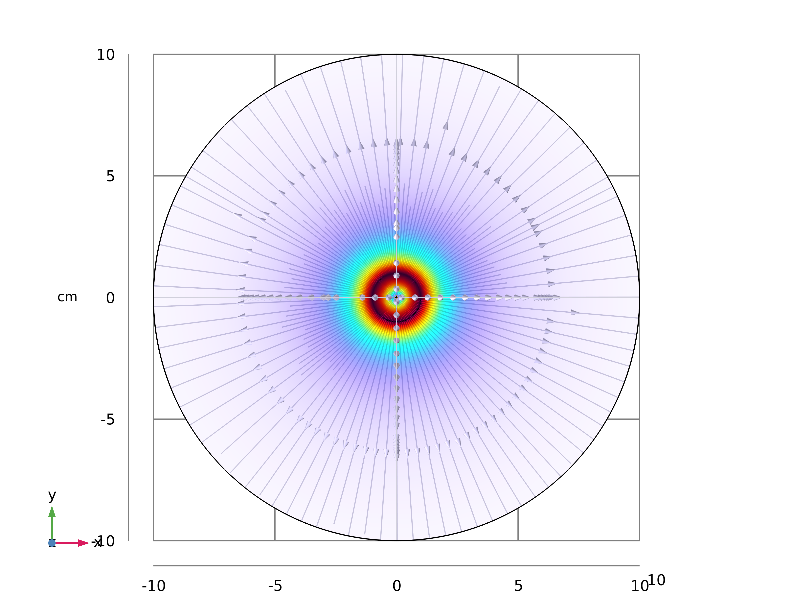
Problem 1
The electric field of spherical clouds
Gauss’s law
The degree of the electric field of spherical clouds
The electric potential

Slide 5
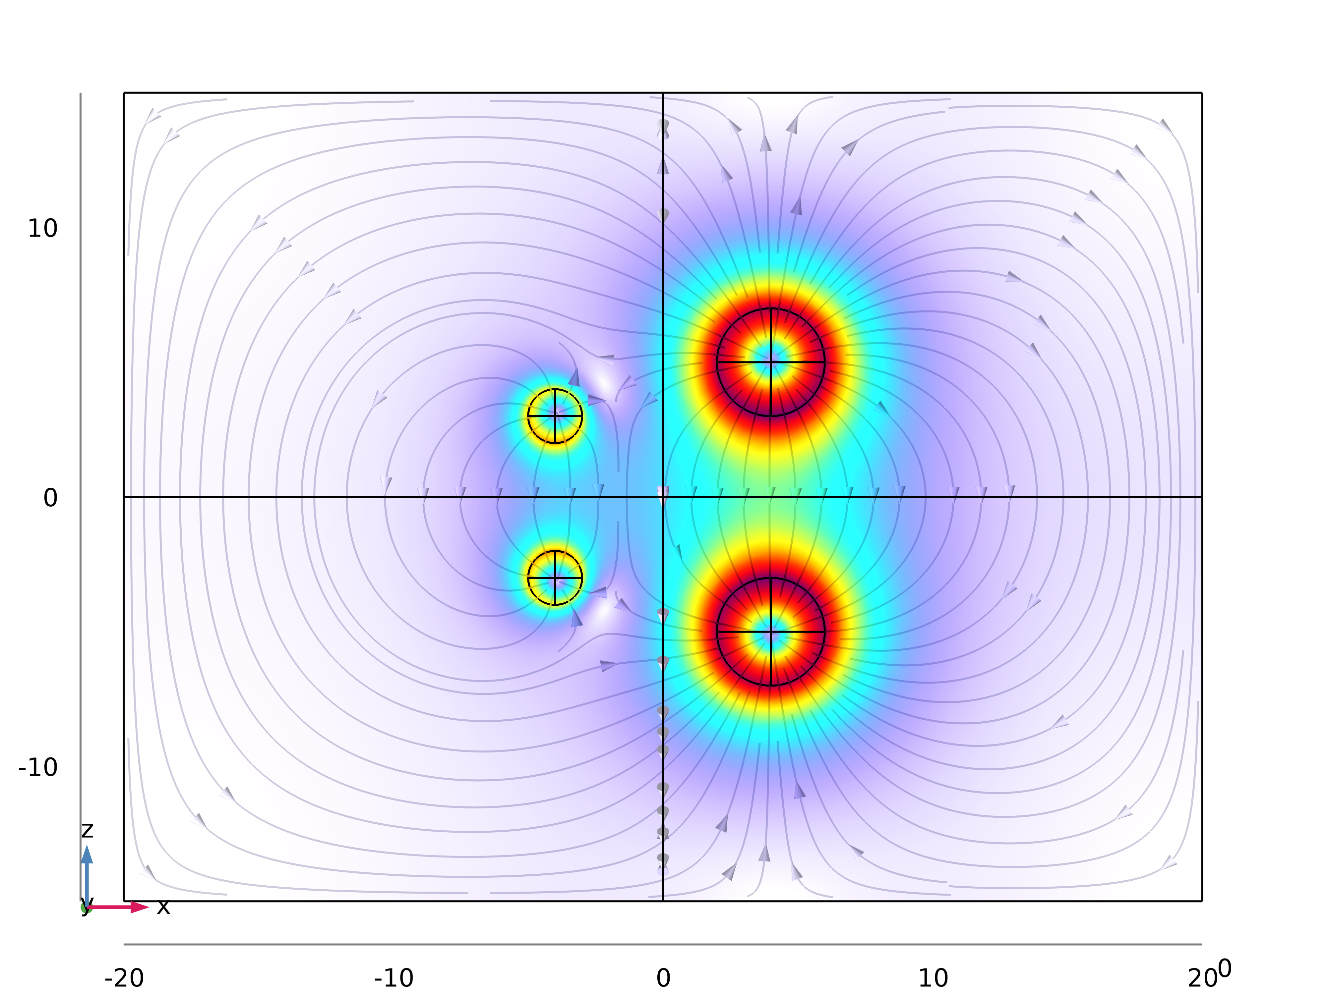
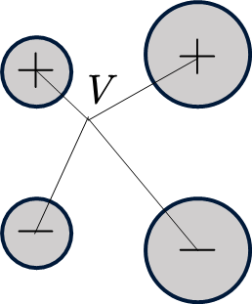
Problem 1
The method of images
The relationship between electric field and electric potential

Slide 6
Problem 1
The solution of the electronic field

Slide 7
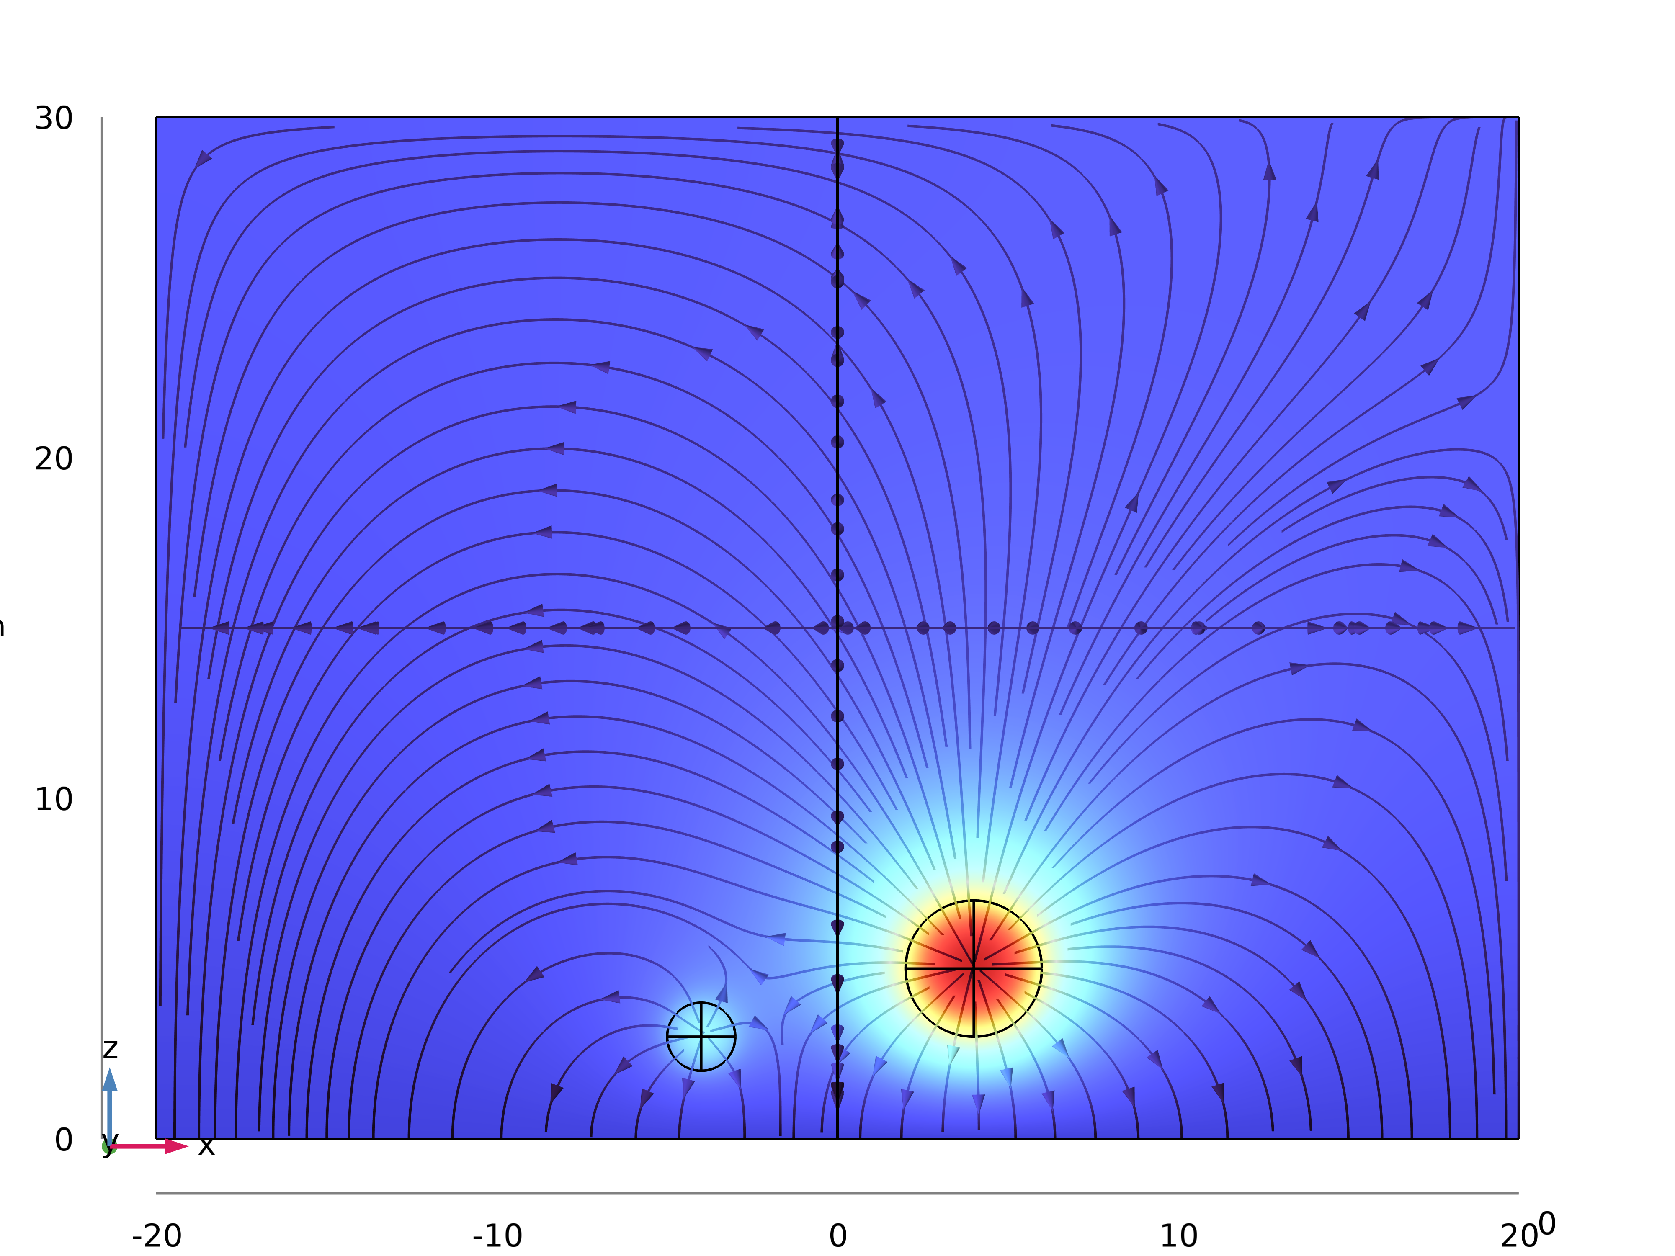
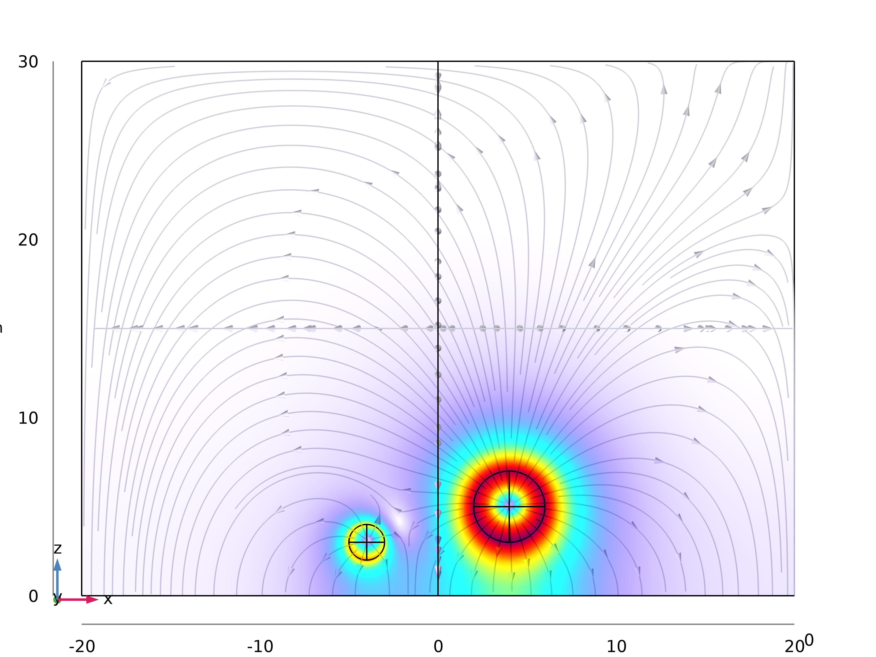
Problem 1
The numerical simulation of the electronic potential and electronic field
Electronic potential
Electronic field

Slide 8
Problem 2

Slide 9
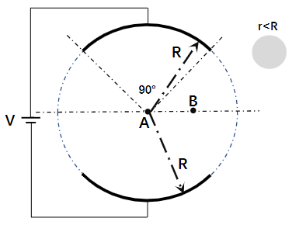
Problem 2
A capacitor with capacitance C is formed by placing two spherical conductors symmetrically against each other. The potential is V. 1）Calculate the electric field inside the capacitor. 2）Re-calculate the electric field when a conductor sphere of radius r is placed at A and B

Slide 10
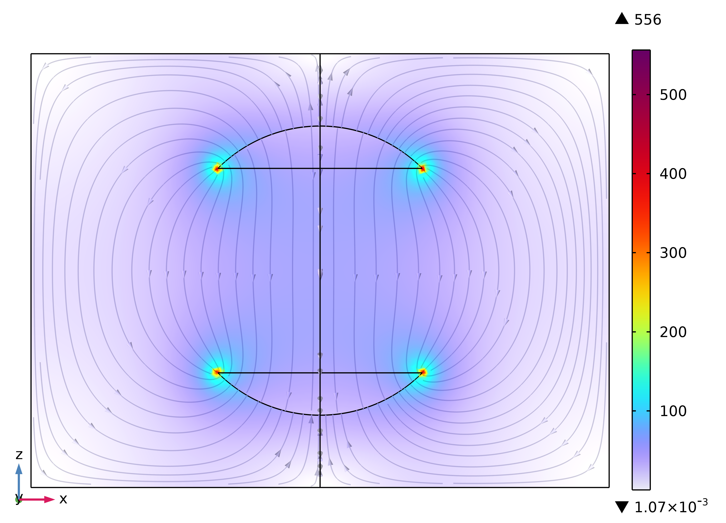
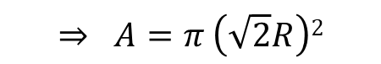

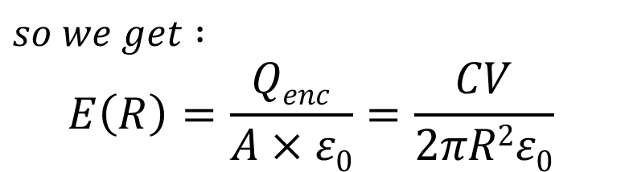
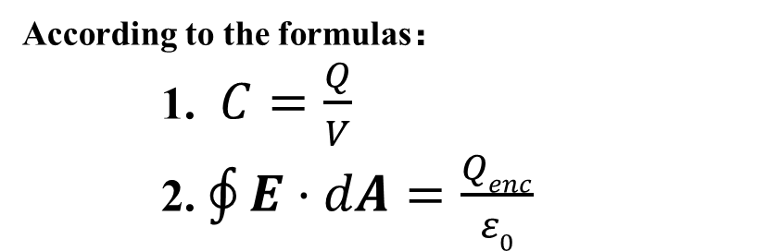
Problem 2
1）Calculate the electric field inside the capacitor
$$so we get :$$
$$E\left(R\right)=\frac{Qenc}{A×ε0}=\frac{CV}{2πR2ε0}$$
According to the formulas：
1. $C=\frac{Q}{V}$
2. $\oint{E·dA}=\frac{Qenc}{ε0}$
Electric field distribution:
Select Gaussian surface:
Spherical conductor
E
$$R$$
$$⇒ A=π \left(\sqrt{2}R\right)2$$

Slide 11
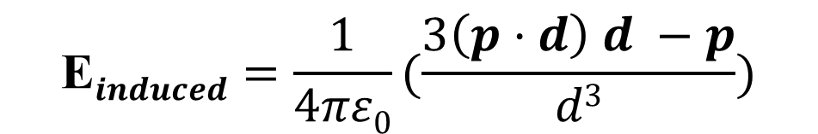
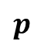
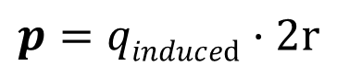
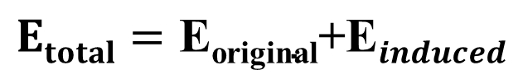
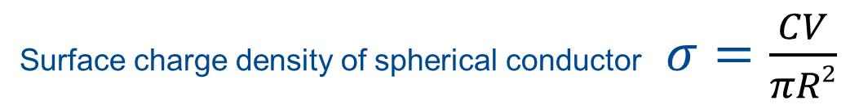
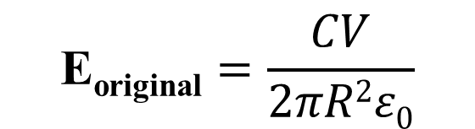
Problem 2
Re-calculate the electric field when a conductor sphere of radius r is placed at A and B
1): In the conductor sphere :
Electrostatic shielding
An induced electric field of equal magnitude and opposite direction is generated inside the conductor
E=0
equipotential body
2): Out the conductor sphere :
$$p=qinduced·2r$$
$$\text{E}induced=\frac{1}{4πε0}(\frac{3\left(p·d\right) d −p}{d3})$$
+++
+
$$p$$
- - -
-
d : The distance between the field point
and the center of the electric dipole
Induced charge
Electric dipole
$$Etotal=\text{E}\text{original}\text{+}\text{E}induced$$
$$\text{E}\text{original}=\frac{CV}{2πR2ε0}$$
Surface charge density of spherical conductor $σ=$ $\frac{CV}{πR2}$

Slide 12
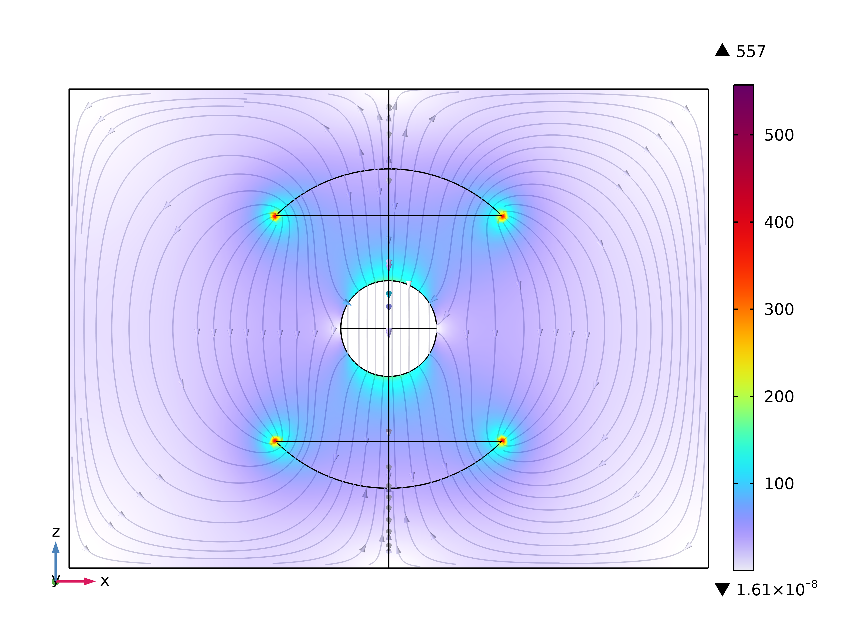
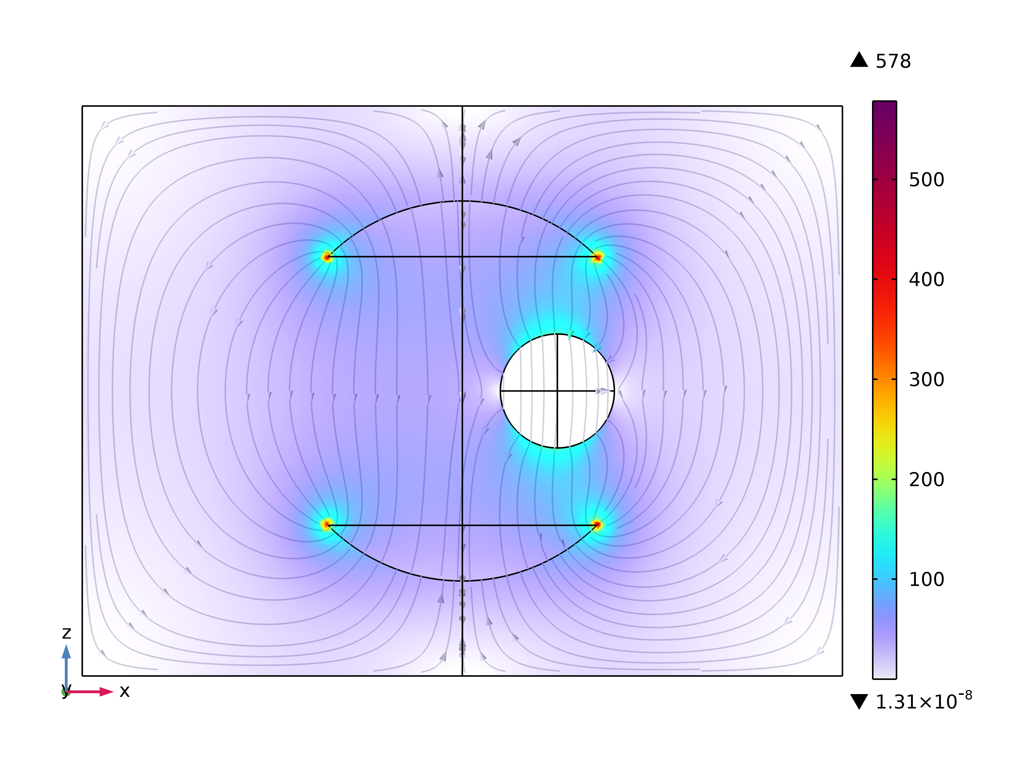
Problem 2
Re-calculate the electric field when a conductor sphere of radius r is placed at A and B
Electric field distribution
A
B
when a conductor sphere is placed at A
when a conductor sphere is placed at B

Slide 13
THANK YOU
School of engineering
September 13, 2024

